Slide 1

Privilege Access Management Training Program
September 3, 2025

Slide 2

Introduction to Privileged Access Management
What is Privileged Access Management?
Privileged Access Management (PAM) is a cybersecurity strategy and technology solution that secures, controls, manages, and monitors privileged access to critical resources within an organization's IT infrastructure.
Why PAM Matters
80% of data breaches involve privileged credentials
Average cost of a data breach: $4.45 million (2023)
62% of organizations experienced privilege-related security incidents.

Slide 3
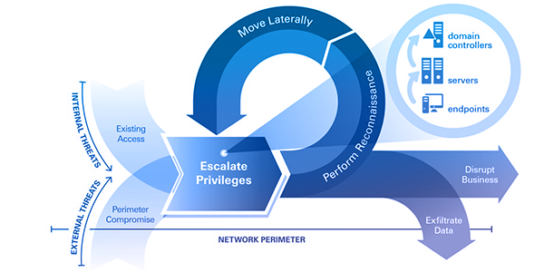
The Privilege Escalation
Attackers follow the below Path to gain access to organisation’s data/application/servers
Initial Access → Lateral Movement → Privilege Escalation → Data Exfil

Slide 4




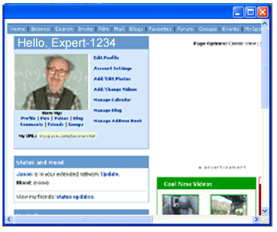
Types of Privileged Accounts
Administrative Accounts
Domain Administrators: Full control over Active Directory
Local Administrators: Administrative rights on specific systems
Database Administrators: Full access to database systems
Network Administrators: Control over network infrastructure
Service Accounts
Application Service Accounts: Used by applications and services
System Service Accounts: Built-in accounts for system processes
Scheduled Task Accounts: Accounts running automated tasks
Emergency Accounts
Break-glass Accounts: For emergency access scenarios
Vendor Accounts: Third-party support access
Temporary Accounts: Short-term access requirements

Slide 5
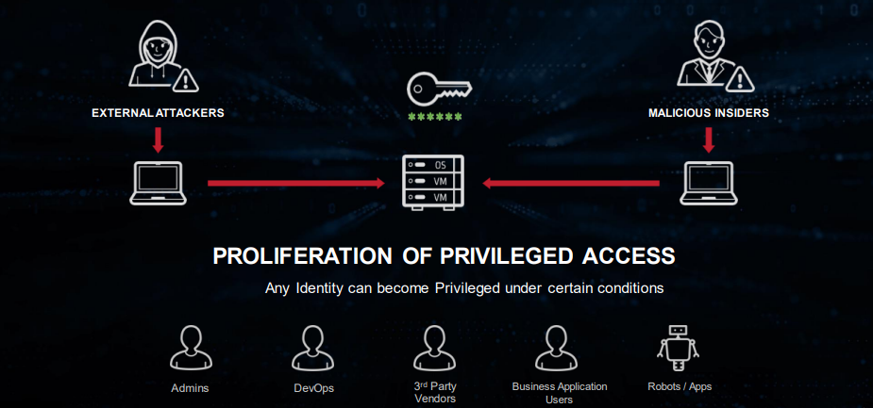
Privilege is Everywhere
All identities can become privilege under certain conditions

Slide 6
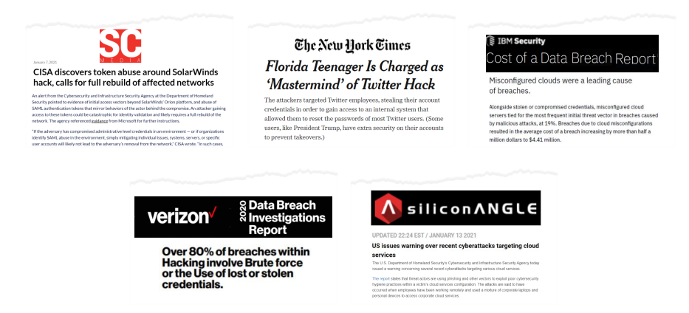
Technologies Change, Attack Path Doesn’t

Slide 7

Privilege Account Compromise and Business Impact
How Privilege Accounts get compromise?
Shared administrative accounts
Hard-coded passwords in applications
Excessive standing privileges
Lack of session monitoring
Poor password hygiene
Business Impact of Poor Privileged Access Management
Business needs to pay ransomware to attackers
Business disruption, reputation damage
Regulatory fines: GDPR, HIPAA, SOX compliance violations
System downtime
Loss of customer trust
Competitive disadvantage
Employee productivity loss

Slide 8
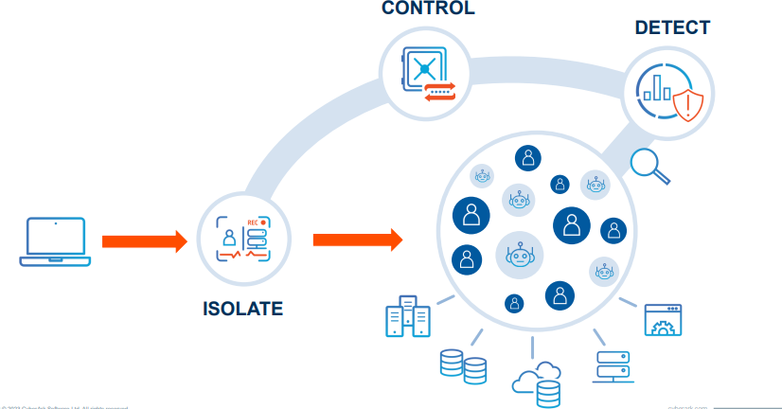

Privileged Access Management Essentials

Slide 9
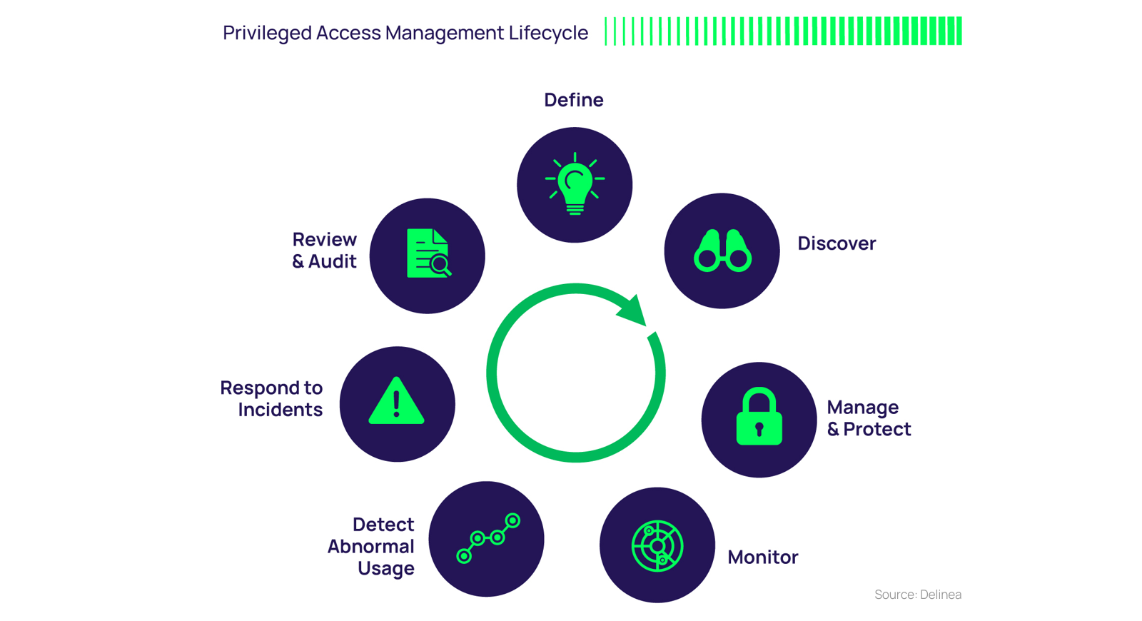
Privileged Access Management lifecycle

Slide 10
PAM Components
Credential Vaulting: Central storage of passwords and SSH keys in encrypted vaults. Eliminates hardcoded credentials and reduces exposure.
Session Recording: Records video and metadata of privileged sessions for auditing and incident response. Helps comply with regulatory frameworks like SOX, HIPAA, and GDPR.
Just-In-Time (JIT) Access: Temporarily elevates privileges for a specific task or time window. Reduces standing access and potential attack surfaces.
Least Privilege Principle: Ensures users have the minimum necessary access. Reduces impact from compromised accounts.

Slide 11
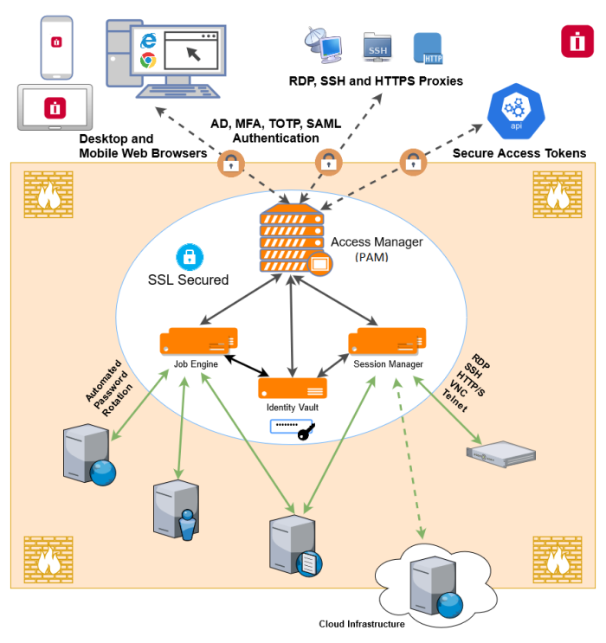
PAM Reference Architecture

Slide 12
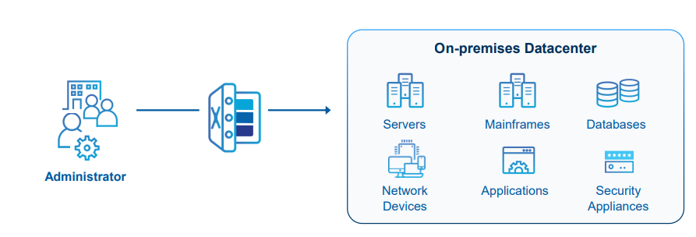
PAM as it Began
Vaulting and rotating credentials for on-premises it systems

Slide 13
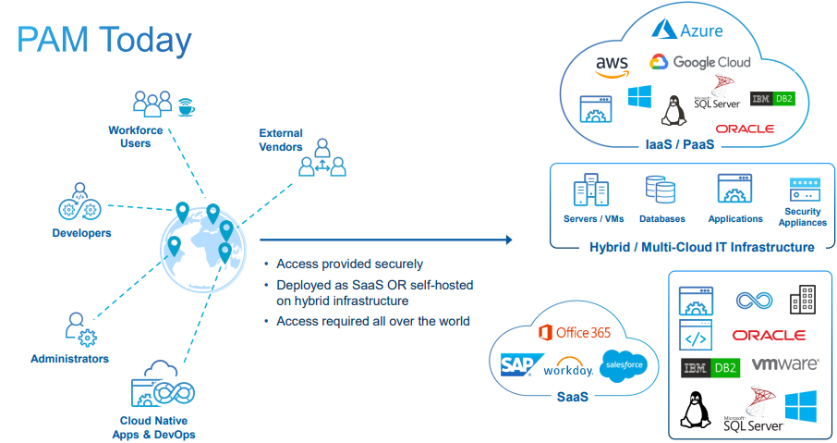
PAM Today

Slide 14
Leading PAM Solutions Overview
The PAM market is dominated by several key players, each offering unique strengths and capabilities. Below are the 3 Industry best PAM tools
Market Leaders (Gartner Magic Quadrant 2024)
Vendor | Market Position | Key Strengths | Target Market
CyberArk | Leader | Comprehensive platform, strong enterprise presence | Large enterprises
BeyondTrust | Leader | Unified platform, strong remote access | Mid to large enterprises
Delinea | Challenger | Strong cloud-native approach, competitive pricing | SMB to enterprise
Technology Comparison Matrix
Feature | CyberArk | BeyondTrust | Delinea
Password Vaulting | ★★★★★ | ★★★★☆ | ★★★★☆
Session Management | ★★★★★ | ★★★★★ | ★★★★☆
Cloud Native | ★★★☆☆ | ★★★★☆ | ★★★★★
Endpoint Protection | ★★★★☆ | ★★★★★ | ★★★☆☆
DevOps Integration | ★★★★☆ | ★★★☆☆ | ★★★★☆
Ease of Deployment | ★★★☆☆ | ★★★★☆ | ★★★★★

Slide 15
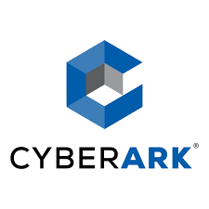
CyberArk Deep Dive
Company Overview
Deployment Models
On-Premises
Full control over infrastructure
Higher initial investment
Suitable for highly regulated org
Cloud (SaaS)
Faster deployment
Lower upfront costs
Automatic updates
Hybrid
Best of both worlds
Risk distribution
Founded: 1999
Headquarters: Petach Tikva, Israel
Market Cap: ~$7 billion
Employees: 4,000+
Core Components PAM
Enterprise Password Vault (EPV)
Central Policy Manager (CPM)
Privileged Session Manager (PSM)
Privileged Threat Analytics (PTA)

Slide 16
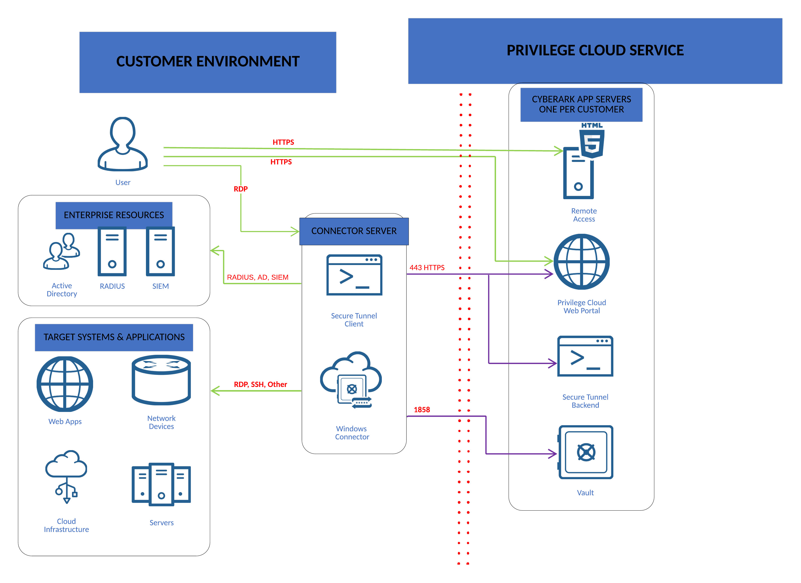
Architecture Diagram -SaaS

Slide 17
CyberArk Key Features
Enterprise Password Vault (EPV)
High availability and DR
Supports 150+ target system
Stores Credentials and Session
Recordings
Central Policy Manager (CPM)
Automatic password rotation
Policy-based password management
Multi-platform support
Secure password generation
Privileged Session Manager (PSM)
Session isolation and recording
Real-time session monitoring
Command filtering and blocking
Protocol support: RDP, SSH, HTTP/S
Privileged Threat Analytics (PTA)
Machine learning-based threat
detection
User behavior analytics
Risk scoring and alerting
Integration with SIEM platforms

Slide 18

BeyondTrust Deep Dive
Company Overview
Founded: 2006
Headquarters: Johns Creek, USA
Employees: 1,800+
Focus: Unified PAM platform
Core Components PAM
Password Safe
Remote Access
Endpoint Privilege Management

Slide 19
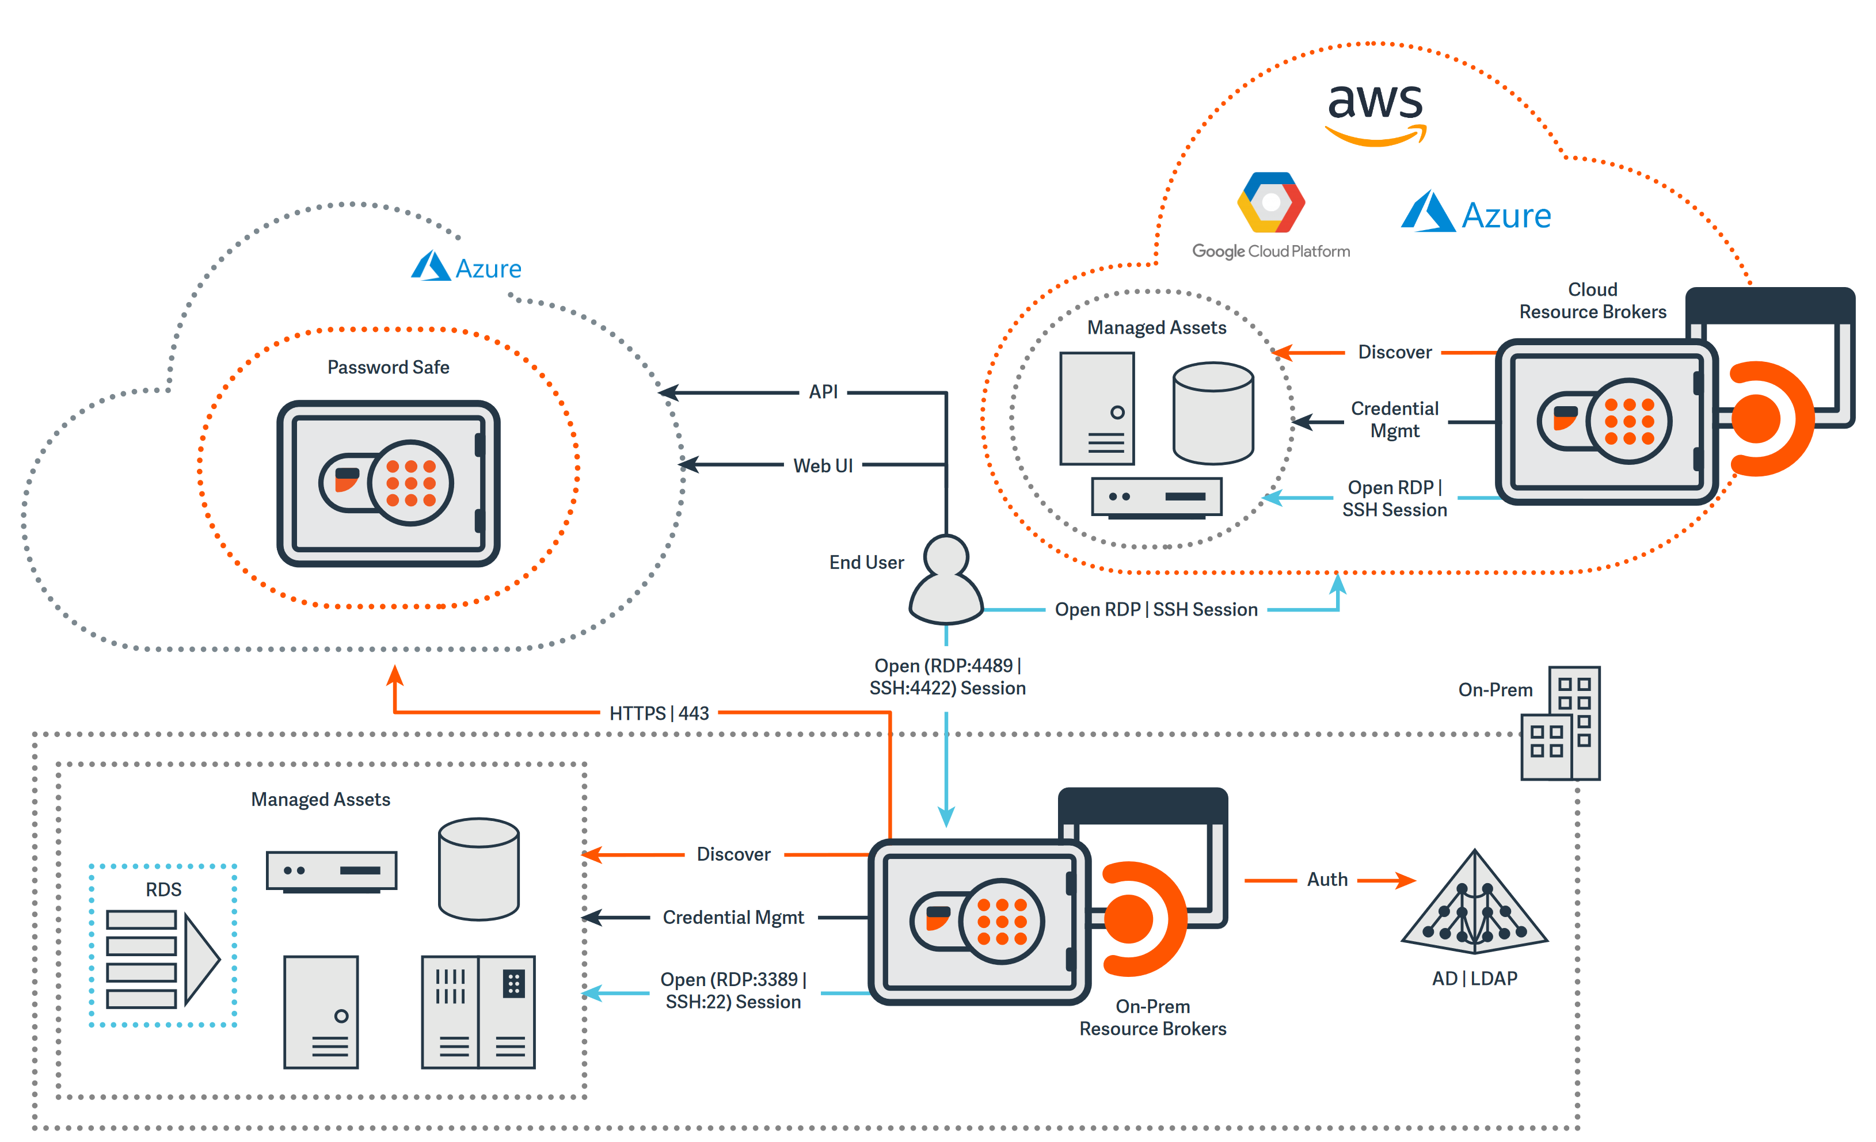
Architecture Diagram

Slide 20
BeyondTrust Key Features
Password Safe
Centralized credential management
Automatic discovery and onboarding
Password rotation and verification
API-first architecture
Remote Access
Secure remote connections
Jump server functionality
Session recording and monitoring
Multi-platform support
Endpoint Privilege Management
Least privilege enforcement
Application control
Credential theft protection
User activity monitoring
Advanced Session Management
Real-time session shadowing
Granular command filtering
Session analytics and reporting
Incident response integration

Slide 21

Delinea Deep Dive
Company Overview
Founded: 2021
Headquarters: Washington, USA
Focus: Cloud-first PAM solutions
Core Components PAM
Secret Server
Privilege Manager
DevOps Secrets Vault

Slide 22
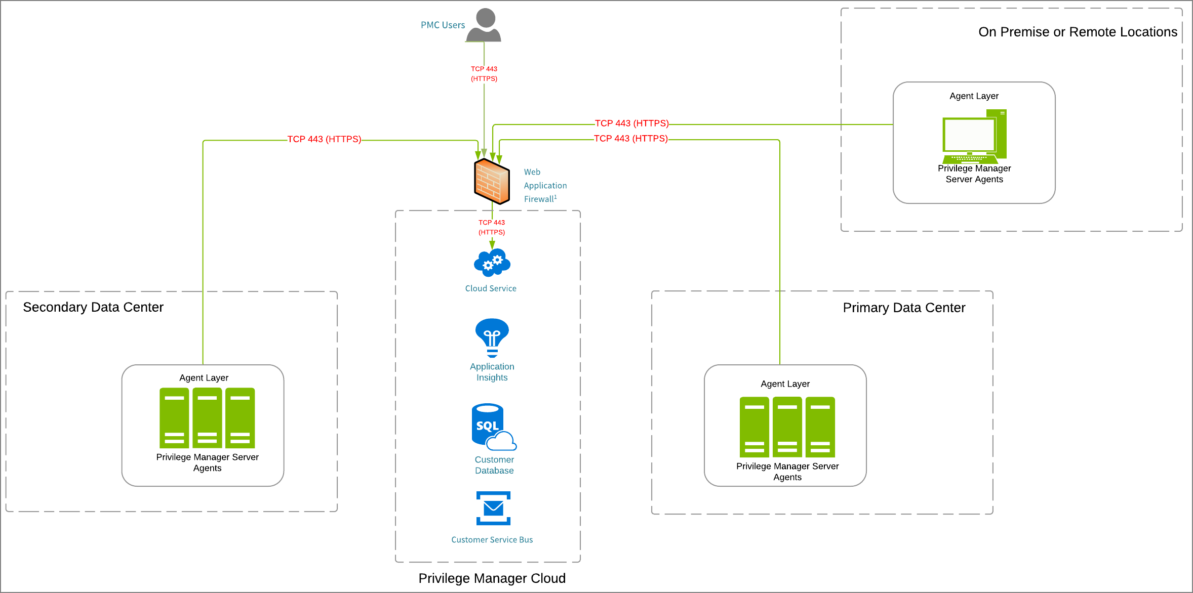
Architecture Diagram

Slide 23
BeyondTrust Key Features
Secret Server
Cloud-native password management
Automated credential rotation
Secure password sharing
Comprehensive audit trails
Privilege Manager
Endpoint privilege management
Application control and whitelisting
Privilege elevation workflows
User behavior monitoring
DevOps Secrets Vault
Developer-friendly secrets
management
CI/CD pipeline integration
API-first architecture
Container and cloud support
Rapid Deployment
Cloud-based setup in minutes
Minimal infrastructure requirements
Automatic updates and maintenance
Scalable architecture

Slide 24
PAM Implementation Strategies
Phase 1 Discovery
Administrative accounts identification
Service account mapping
Emergency account documentation
Shared account analysis
Stakeholder Mapping
Phase 2 Implementation Methodology
Install and configure PAM platform
Establish basic security policies
Create administrative procedures
Phase 3 Onboarding
Onboard critical privileged accounts
Implement password rotation
Configure session management
Phase 4 Integration
Integrate with existing systems
Configure SIEM connectivity
Implement workflow automation
Phase 5 Optimization
Fine-tune policies and procedures
Implement advanced features
Conduct user training
Phase 6 Continuous Improvement
Just-in-time access
Privileged analytics
Threat detection
Compliance reporting

Slide 25

Common Implementation Challenges
Challenge: Application compatibility issues
Solution: Gradual rollout with thorough testing
Challenge: Network connectivity problems
Solution: Proper network planning and firewall configuration
Challenge: Performance impact
Solution: Capacity planning and optimization
Challenge: User resistance to change
Solution: Comprehensive training and change management
Challenge: Resource constraints
Solution: Phased implementation approach

Slide 26
PAM Best Practices
Governance and Strategy
Privileged access policy documentation
Role-based access control (RBAC) matrix
Password management standards
Emergency access procedures
Principle of Least Privilege
Zero Standing Privileges: Remove permanent administrative access
Just-in-Time Access: Provide temporary, purpose-specific access
Role-Based Permissions: Assign minimum required permissions
Regular Access Reviews: Quarterly privilege certification

Slide 27

PAM Best Practices
Governance and Strategy
Privileged access policy documentation
Role-based access control (RBAC) matrix
Password management standards
Emergency access procedures
Principle of Least Privilege
Zero Standing Privileges: Remove permanent administrative access
Just-in-Time Access: Provide temporary, purpose-specific access
Role-Based Permissions: Assign minimum required permissions
Regular Access Reviews: Quarterly privilege certification
Password Policy Standards:
Complexity: Minimum 14 characters, mixed case, numbers, symbols
Rotation: Automatic rotation every 30-90 days
Uniqueness: No password reuse across systems
Storage: Encrypted vault with AES-256 encryption

Slide 28

PAM Best Practices
Session Management
Session Recording: 100% of privileged sessions recorded
Real-time Monitoring: Active session surveillance
Session Timeout: Maximum 4-hour sessions
Multi-factor Authentication: Required for all privileged access
Change Management
Change Request: Formal documentation required
Impact Assessment: Risk and business impact analysis
Implementation: Controlled deployment with rollback plan
Validation: Post-change verification and testing
Monitoring and Alerting
Failed authentication attempts (threshold: 5 failures/hour)
Unusual access patterns (off-hours, location anomalies)
Privileged account creation/modification
Password policy violations

Slide 29
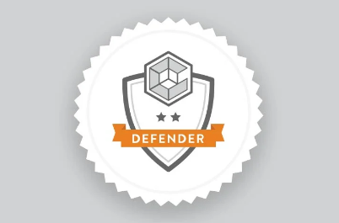
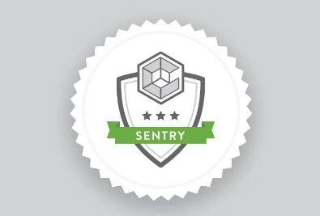

CyberArk PAM Certification Path

Slide 30
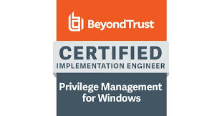
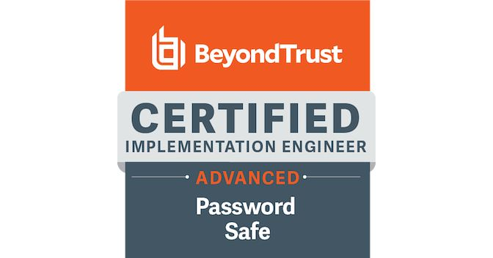
CyberArk PAM Certification Path

Slide 31
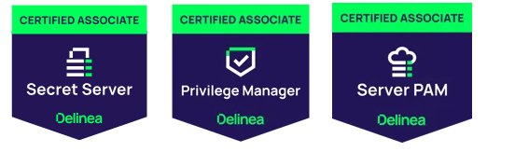
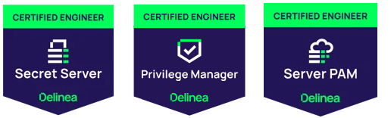
Delinea PAM Certification Path

Slide 32

PAM Case Study A Leading Global Tier Manufacturing Company
One of the world’s biggest tire manufacturing company
Business Drivers
TCS Solution
Company has experienced a ransomware attack, which rendered their systems unusable via an encryption mechanism.
Company has four business units (US, Japan, Asia, Europe) which handle their privileged access differently with different definitions of privileged access, policies, and procedures with varying degrees of maturity.
All business units have expressed a struggle with knowing what their privileged account landscape looks like but acknowledged the risk associated with this gap.
Most business units raised concerns about the operational support of a global PAM program, questions about how it would integrate with their existing solutions that handle privileged access, and how this would be funded.
Region specific regulations (GDPR, JSOX, SOX) do not appear to have a heavy influence on how business units handle privileged access.
Reporting and tracking of privileged account usage and creation is not widely implemented.
CyberArk Deployment
Defined and documented network, hardware, software requirements, and third-party integration requirements to deploy Privilege Cloud.
Define and document solution design architecture with respect to the regional requirement.
Performed deployment of CyberArk Privilege Cloud Connectors in environment.
Integrated Privileged Cloud with global Active Directory instances and multi-factor authentication solutions.
Integrated Privileged Cloud with global SIEM for log forwarding, monitoring, and alerting.
Accounts Discovery & Onboarding
Discovered and prioritized the onboarding of Tier 1 and Tier 2 accounts (enterprise, domain, cloud admin accounts) within each region through a combination of discovery scans and questionnaire templates.
Prepared automated onboarding templates and scripts, socialize upcoming changes with key stakeholders, and establish organizational change management processes to facilitate onboarding of accounts.
COE Build and Operationalization
Established privileged account intake processes, Global PAM support queues, and issue management processes across global regions.
Established automated processes to continuously onboard net new privileged accounts.
Develop training content, guides, and QRCs to create end-user awareness on new processes, capabilities, and support resources.
Develop operational runbooks to enable the Global PAM Operations team to support end-users to address queries, requests, and issues.
Service Account Discovery & Onboarding
Conducted service account deep dives with all the critical application owners
Categorized accounts based on need for custom development involved in order to enable credential management.
Developed onboarding, integration plan, and testing plans.
Conducted account functionality and access validation post credential management being enabled.
Benefits
Deployed PAM solution to 12 sites and ten countries
Protects 20,000 global privileged accounts without impacting global operations.
Passwords are regularly rotated and hidden from users.
Consolidates global privileged access onto a single platform
Leverages a single solution for a complex hybrid and multi-cloud environment for human and non-human identities

Slide 33

Case Study: Tyre Manufacturer Implements CyberArk PAM
Company Profile:
Industry: Manufacturing
Annual Revenue: USD 37.45 billion (Worldwide)
Employees: 1,30,000
Challenges:
Managing the widespread proliferation of privileged credentials.
Reducing the number of privileged entitlements throughout the environment.
Ensuring governance and segregation of duties to manage privileged access effectively.
Solutions:
CyberArk PAM was deployed to gain visibility and control across user accounts.
Role-based access security was designed with the principle of least privilege. Just in Time access was also enabled.
Stakeholders identified the company's most critical data and highest risk applications to prioritize the rollout of privileged access controls.
Results:
Enhanced control over privileged accounts.
Improved security posture by mitigating risks associated with privileged credentials.
Successful collaboration with stakeholders to implement role-based access controls.

